Slide 1

Be one the business!
Corporate Loan Platform
BEONE
Korea Polytechnics
Data Analysis Department Leena Kim

Slide 2
01. Service Backgrounds & Traits
Lack of digital loan products
Fast non-face-to-face cash transfusion
Improved
Inconvenient screening and procedures
AI Loan Rate Review
Loan documents to go through a tax accountant
A filing cabinet with
a tax accountant

Slide 3


02. Service Functions
Enterprise
Bank
Loan
Application
Submission of
loan documents
Account
Loan
account
inquiry
Transaction
history
inquiry
etc
Tax accountant
certification
Company
analysis
report
Loan application
status inquiry
Loan history inquiry
Reimbursement and
repayment history inquiry
automatic
interest payment
business
dashboard
New loan inquiry
Existing loan inquiry
Loan Review
Financial Statement
Validation
AI Loan Rate
Review
Loan Management
Overdue trend
inquiry
Overdue and
repayment history
inquiry
New loan from
our branch
My loan number
trend
Add interest loan
Final review
Company information, repayment, interest, financial status inquiry
National Bank Loan
Status Dashboard

Slide 4
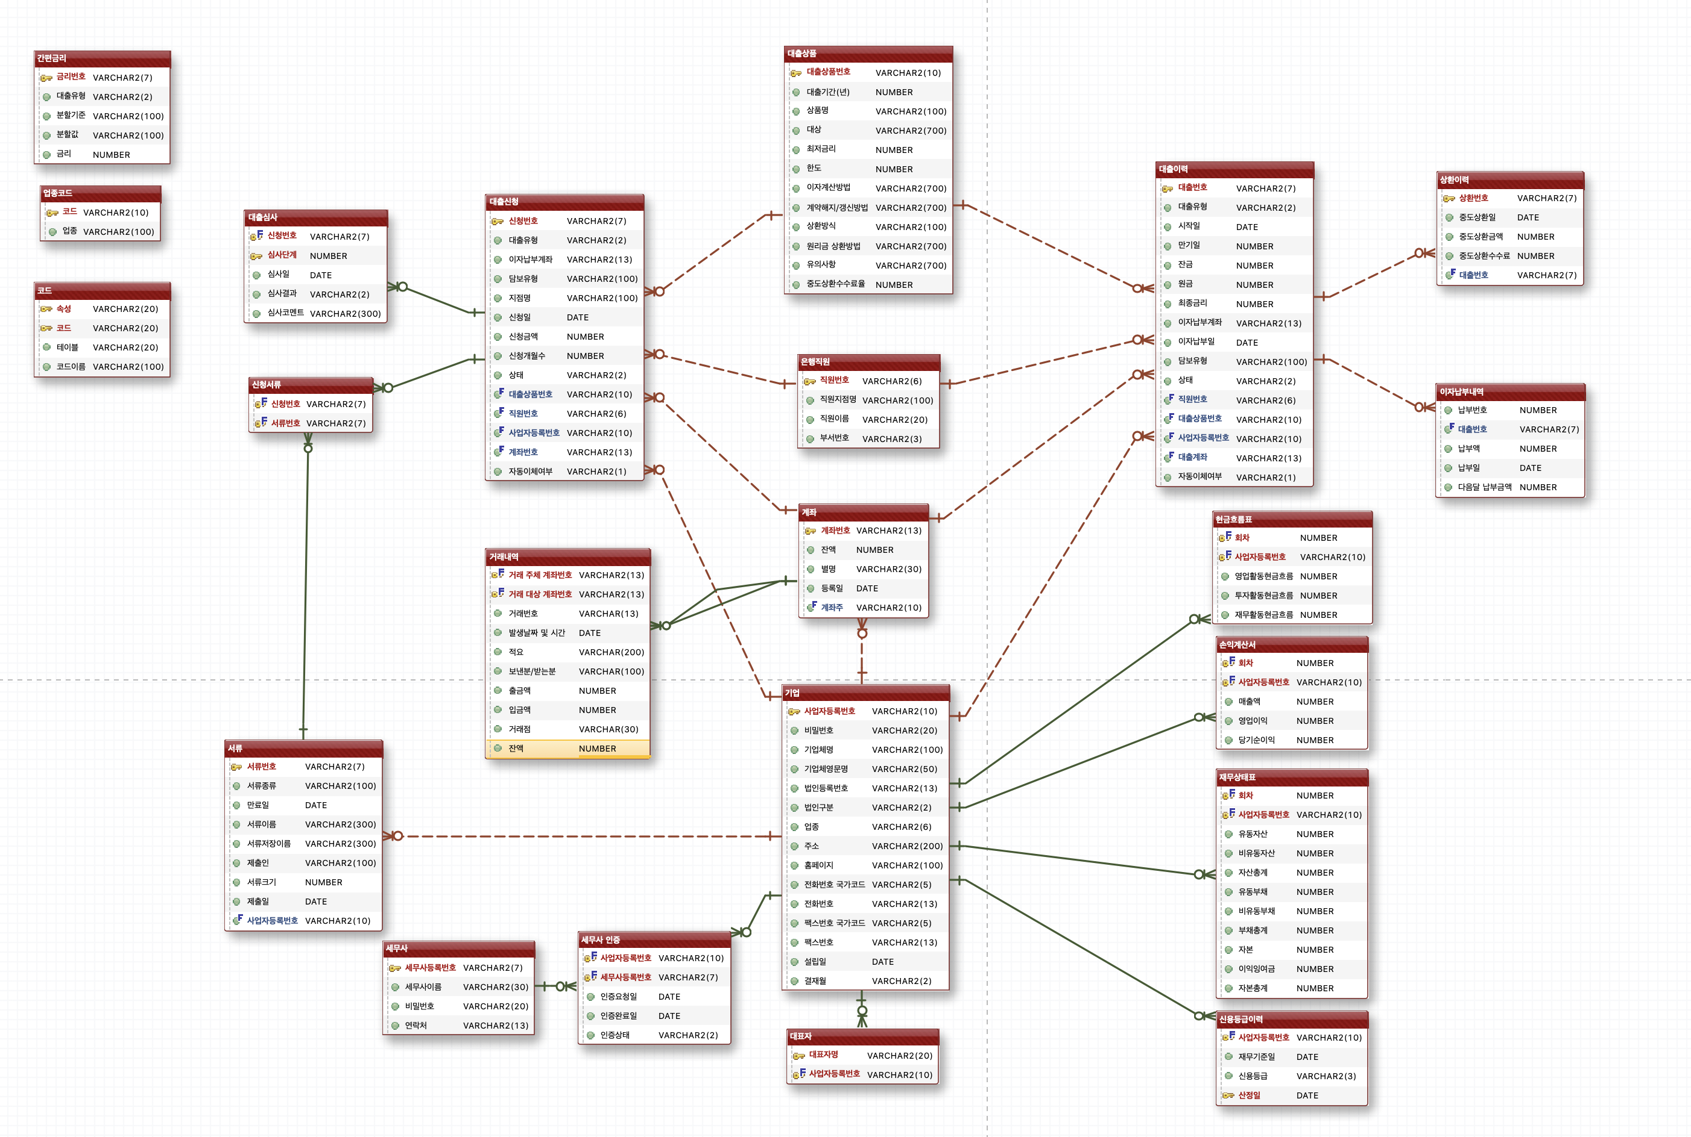
03. ERD
Quick
interest
Loan
Products
Industry code
Loan
Application
Loan
History
Repayment
History
Loan Review
Code
Application docs
Bank
employees
Interest payment history
Accounts
cash flow statement
Transaction
History
Income Statement
Enterprise
Docs
statement of financial position
Tax Accountant
Tax Accountant
Validation
CEO
Credit rating history

Slide 5






04. Project Architecture
FRONT-END
For management and internal access
192.168.113.0/24
.100
.101
.102
Web Instance
DB Instance
BACK-END
172.16.1.0/24 (virtual switch)
R1
SERVER
.100 (Control)
.101 (Compute1)
.102 (Compute2)
.2
5.5.5.0/24
for external connection
Internet

Slide 6
05. Applied Technology
corporate disclosure site API
Data Extract
Python
Data Cleansing
PLSQL
Loan
Dummy Data
Creation
Major tables
Index
Processing
Logback Mybatis
Real & Dummy Data Processing

Slide 7
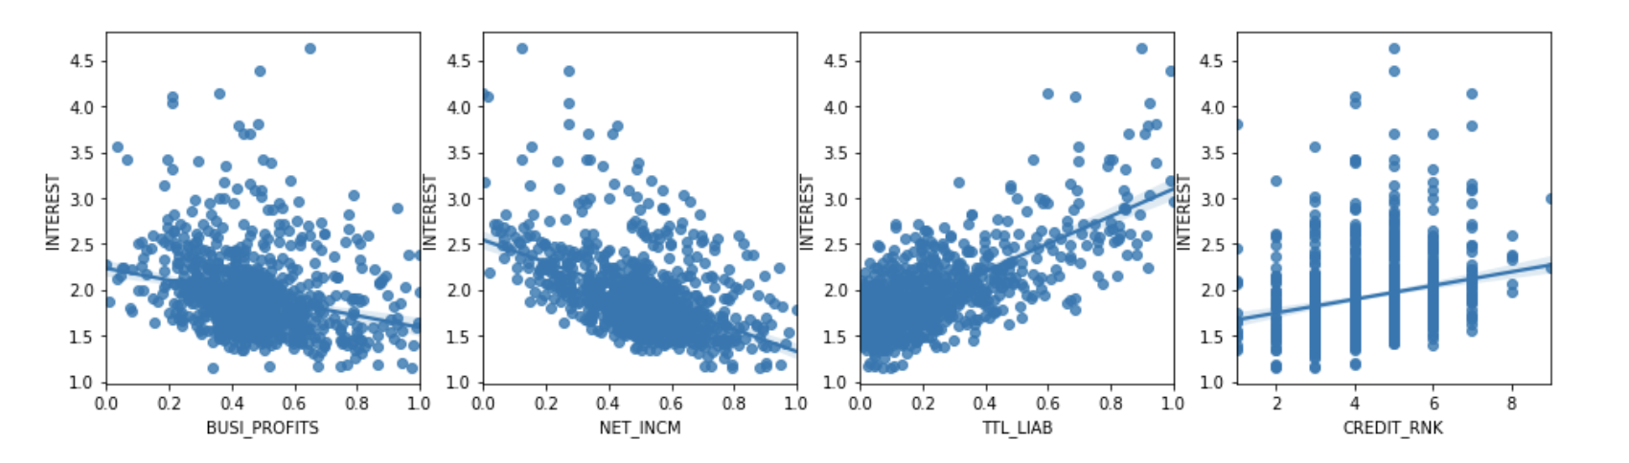
05. Applied Technology
Deriving predictive regression models through machine learning
Interest
Operating profit
Net income
Total debt
Credit rank

Slide 8
05. Applied Technology
Building a cloud environment using Openstack
3-node Server build
Connect Router
Configure Security Group, Key-pair, Glance, Flavor
Set and connect Web/WAS, DB-server
Allocate Floating IP
to Web-server

Slide 9

06. Summary of Scenario
1
Validation
Corp
Bank
Corp
Corp
Accountant
2
4
5
7
Upload Docs
Loan Application
Financial Statement Validation
AI rate review
Final
Review
Loan account management
Interest & Repayment Management
3
6
Corporate Growth Report
Loan Management
Overall Loan Status

Slide 10
ON AIR
07. Demonstration Video

Slide 11
Thank you

